Slide 1
Advanced Systems Analysis and Design Defining your teams’ definition of “done”. SOFT 30121 L20 Presented By Nigel King ACMA CGMA PCM Nigel.King@ntu.ac.uk

Slide 2
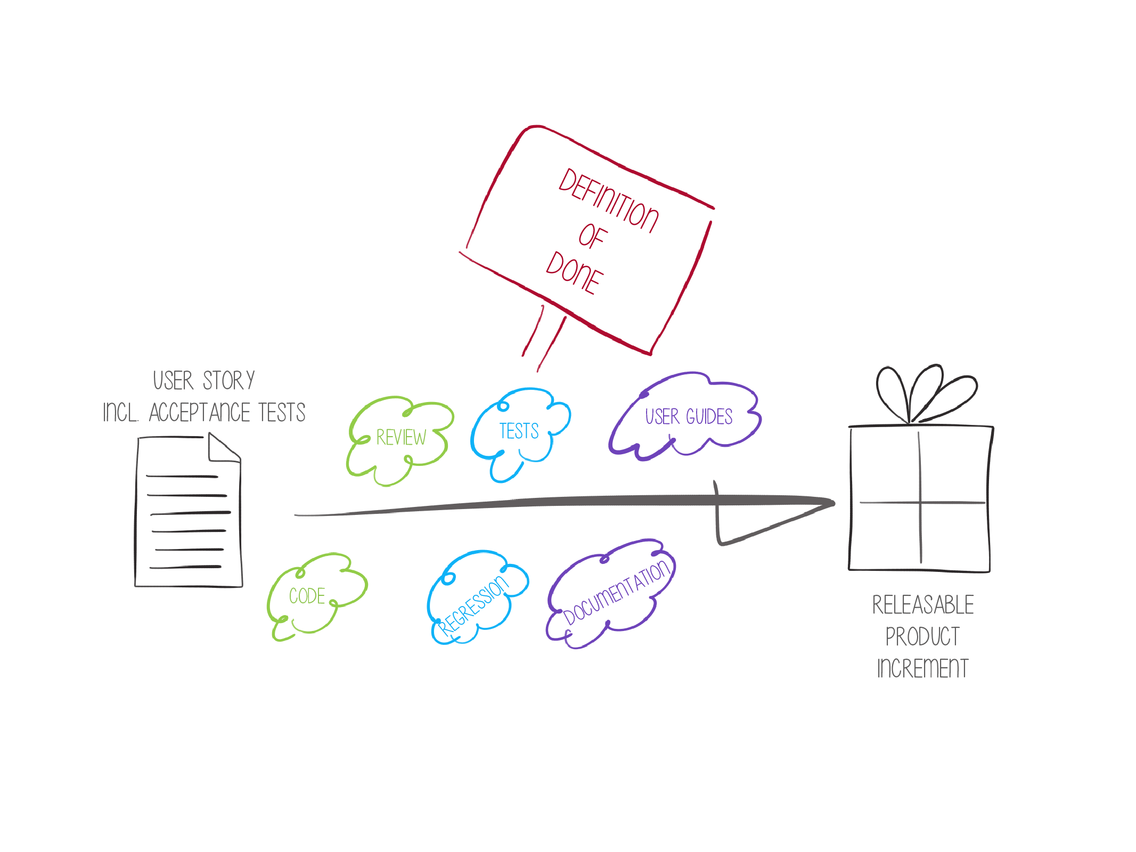
Defining your teams’ definition of “done”.

Slide 3
The Big Picture
Constructing your sprint plan
Defining your teams’ definition of “done”.
Conducting Scrum Meetings
Conducting Reviews

Slide 4
Defining your teams’ definition of “done”.
What do we mean by definition of done. Done? Or Done Done?
Important in the agile concepts, is that we are “releasable” at every sprint. This is a laudable objective. However agile a development team is, I have generally seen downstream quality hurdles for major releases, that development teams release to.
Product Branch, Feature Complete
Integration Branch, All products merged
Release acceptance, Build is generally OK.
Regression Test, All previously delivered features still work.
Volume Test, response times do not degrade at data volumes or concurrent load.
Customer Data. Test data is generally designed to test features. It is always useful to test with customer’s actual data.

Slide 5

Defining your teams’ definition of “done”.
What do we mean by definition of done. Accountability
However, the development team all need to agree on what done means when they pass to the next step in the chain. This is an important piece of mutual accountability and being able to rely on each other.

Slide 6

Defining your teams’ definition of “done”.
What do we mean by definition of done.
At Oracle we used to have a step in the plan of “Development Handoff to QA”. This later got called “Feature Complete”, because different teams had different relationships with the central QA teams.

Slide 7
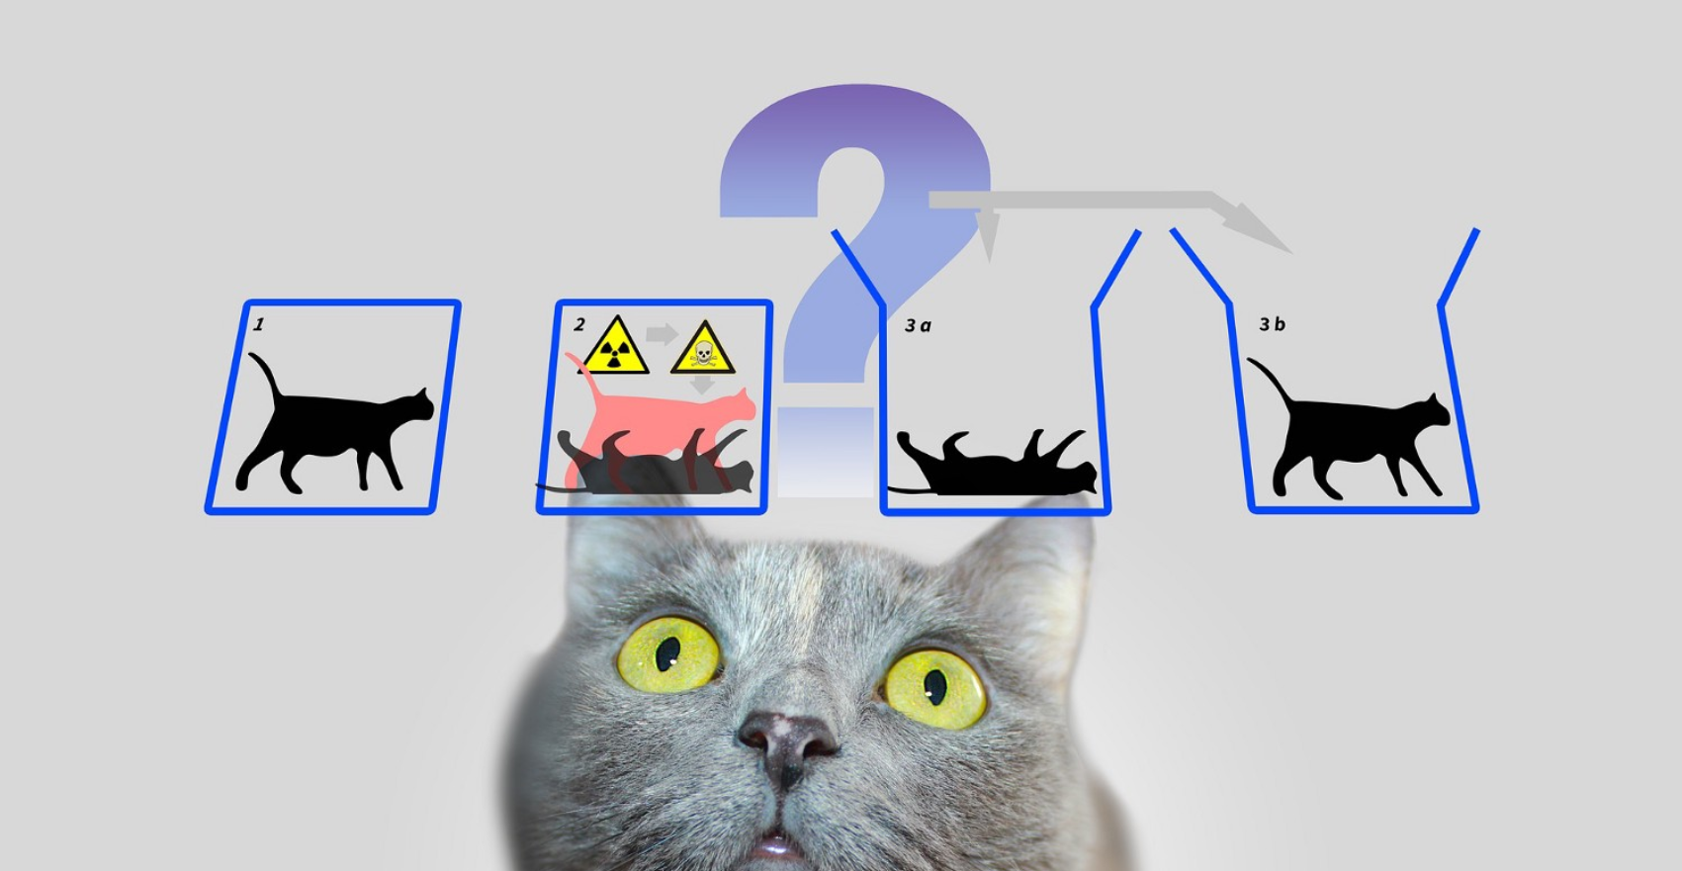
Defining your teams’ definition of “done”.
What do we mean by definition of done. Management Visibility
At Oracle senior management wanted to see internal bug count go up at this early stage. We wanted people that were not the development team involved in testing. Latent defects are killers, so it was senior management’s read on QA actually working.

Slide 8

Defining your teams’ definition of “done”.
What do we mean by definition of done. Inadeqate DOD
However, we would expect that unit test was complete. If I submit a page and lose data I am pretty unhappy. Development managers that claim features were complete without adequate unit testing did not last long.

Slide 9
Defining your teams’ definition of “done”.
What do we mean by definition of done. – Roles at Oracle
Dev manager was a term for a management level in Oracle that had responsibility for all code deliverables: Dev, Unit Test, Release Management. Maybe 3-4 years of experience. Maybe 4-6 Engineers. Progression from Principle Engineer / Project Lead.
Dev = Can you demo it doing what it was supposed to do
Unit Test = Can you break it.
Release Management = Does it merge / install. Does it still work. Does it break other stuff when it installs.
Product managers would be responsible for non code deliverables
Sales Enablement
Consulting Enablement
Support Enablement
Customer Training Enablement
The management chain joined above these. It is a pretty big ship to steer.

Slide 10


Defining your teams’ definition of “done”.
What do we mean by definition of done. Latitude within Teams
When agile became more in vogue, our definition of done became broader and more formal. Oracle was not a small team focused company though, so this kinda became checklists that were declarations and barriers to merging code. One of Steve Miranda’s phrases was “This is not a democracy”. He would listen to your input on why your team’ definition of done should be different, but his decisions were final. It felt a little less like mutual accountability.
There was a decent amount of tension between management’s desire to surface risk and engineering’s desire to let the teams develop and be accountable for their process.

Slide 11

Defining your teams’ definition of “done”.
What do we mean by definition of done. Latitude within Teams
Powerschool while a much smaller company was much more devolved. We had to be careful not to crush the acquired company development teams under the weight of unfamiliar procedures. Teams were at liberty to bring their own methodology with them. As an executive team though, we had a very good handle on the velocity of each team. We knew very quickly if they were not moving. We knew very quickly if bugs were escaping their process. Teams would politely be asked to adopt VISTA’s standard operating procedures.

Slide 12
Defining your teams’ definition of “done”.
Things to consider in your teams definition of done
If you do not force test automation in to your definition of done, you will never get round to it.
There are always new customer requirements to work on.
You can always test manually to get through the current release.
Test Automation backlog will accumulate, and will become technical debt.
If you are going to be “releasable”, someone has to know how to use the product.
Releasable might mean much more than just functionally complete.
Performance testing
Usability test
Security testing
You need to have a process that includes the people that can derail you.
Product Owner
UX Design

Slide 13
Defining your teams’ definition of “done”.
Review of an example from SSTC ltd
Code is peer-reviewed
Code is deployed to test environment
Feature is tested against acceptance criteria
Feature passes build acceptance test
Feature is documented
Feature ok-ed by UX designer
Feature ok-ed by Product Owner

Slide 14
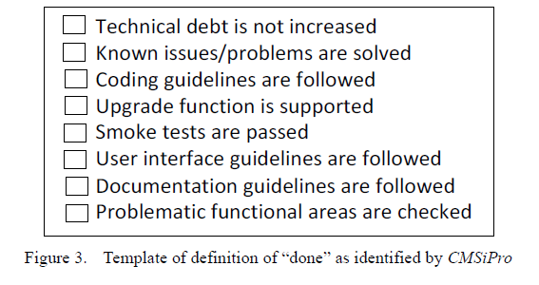
Defining your teams’ definition of “done”.
Review of an example from CMSiPro

Slide 15
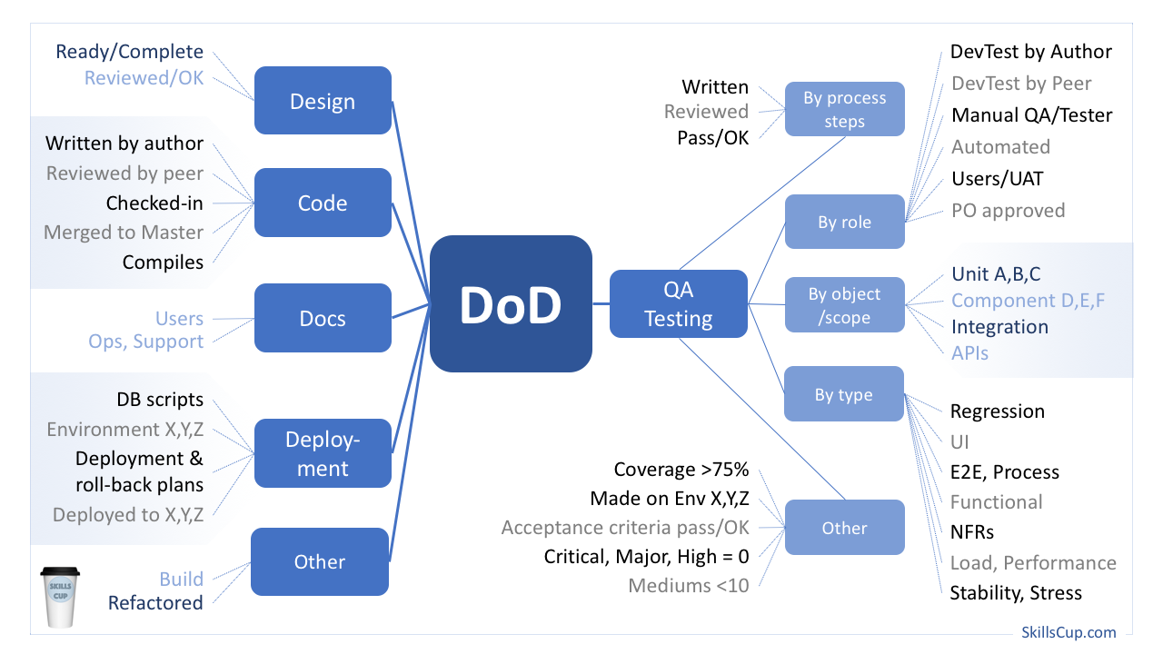
Defining your teams’ definition of “done”.
Review of an example from SSTC ltd

Slide 16
Defining your teams’ definition of “done”.
Review of an example from SSTC ltd. Definition of Ready
Decide Themes for the release
Check we have most large items.
Assign ABC Category to everything
Force Rank the "A"s
Size Everything for complexity (Tee Shirt Sizing)
Put the A's into Year and Quarter buckets. Determine features in the next release.
Put B's and C's into Year buckets in Year 2 through 5
Balance the portfolio against resources: Factor, PM, QA, Integration and Packaging, Doc
Balance the Portfolio: Bugs 25% (support), Enhancements 25% (PM), Features and Products 50% (PM and Strategy)
Plan 2 Week sprints. Any line item that goes into a sprint must be decomposed into something that is 2 weeks to develop, test and integrate.
Anything not in the current sprint, goes back into the backlog
Backlog is maintained in Bug
User Stories must be complete before feature can move to sprint elligible. PM to deliver. Product Owner to sign off.
Results of sprint must be demoed at end of sprint. Anything of use is valid: user stories, UI mockups, process flows working code.
Tickets in sprint must be accepted by product owner according to Definition of Done.
Hold sprint retrospective.
Comb the backlog to reset forced ranking, absorb new requirements. Rinse and repeat.
Track Story Point Burn Down toward the release. Be aware that the backlog may go up as you discover complexity. The objective is a consistent burn rate.

Slide 17
Defining your teams’ definition of “done”.
User Stories.
What is a User Story?
a small, self-contained unit of development work designed to accomplish a specific goal within a product. A user story is usually written from the user’s perspective and follows the format: “As [a user persona], I want [to perform this action] so that [I can accomplish this goal].”
Why User Stories rather than requirements
User Stories represent bite-sized deliverables that can fit in sprints, whereas not all full features can.
Example user story
As a brand manager, I want to get alerts whenever a reseller advertises our products below agreed-upon prices so that I can quickly take action to protect our brand.

Slide 18
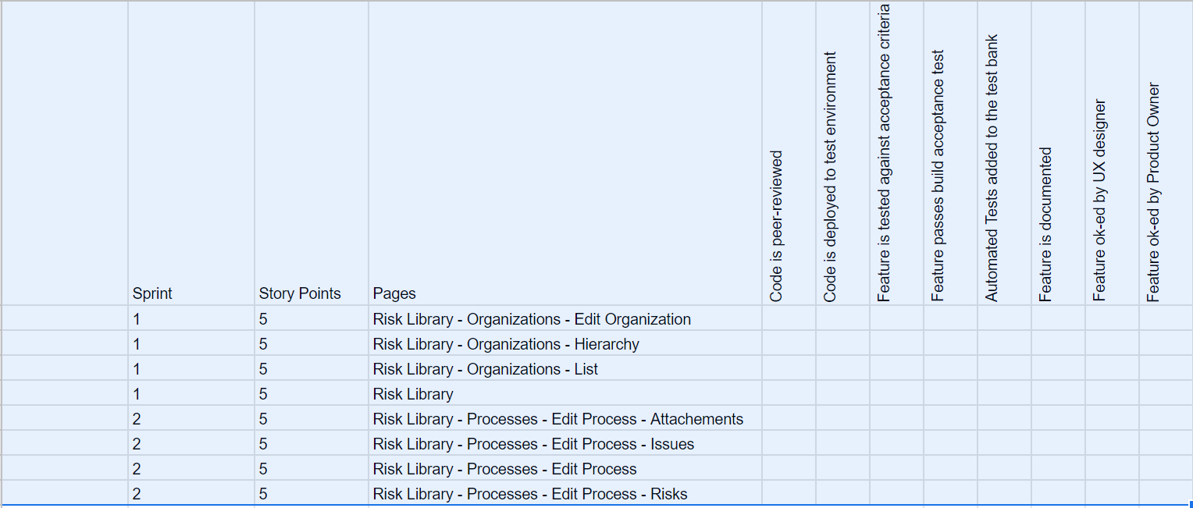
Defining your teams’ definition of “done”.
Integrating DOD into Sprint Plan
Definition of Done
Features within Sprints

Slide 19
Questions
What step is generally not part of the definition of done
End User acceptance test
UX Sign off
Product Owner Sign Off
Documentation Complete
What deliverable is generally part of definition of ready
Strategic review
User Story
Product Sizing
Wireframe

Slide 20
Next Lecture
Conducting Scrum Meetings.

